Slide 1
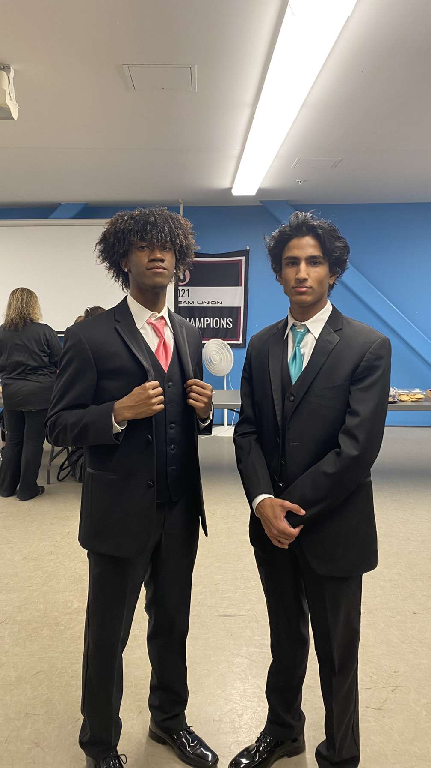
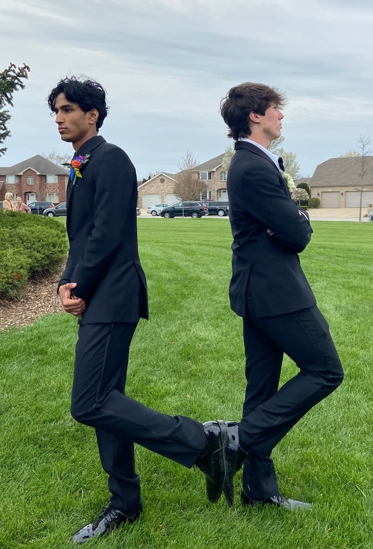
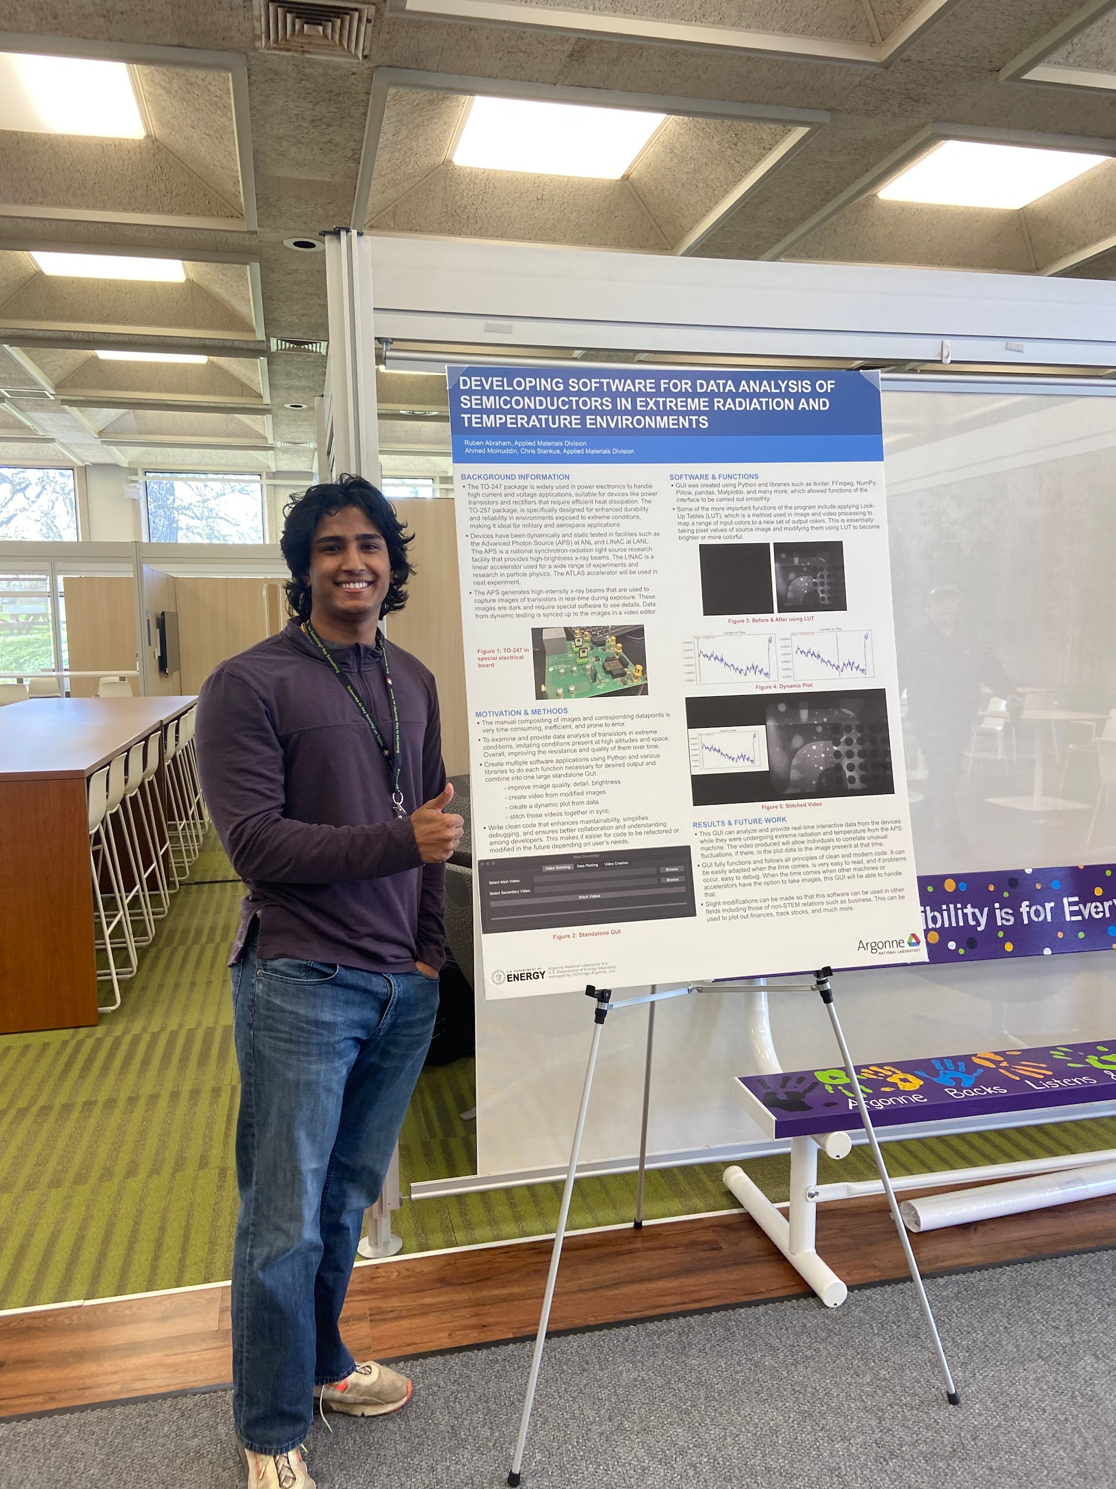
Ruben Abraham, University of Illinois Urbana-Champaign, Tinley Park, IL
SAGE/Waggle Research
Goals: To provide a baseline of solar irradiance estimation, observing pre-trained models in the real-world, to accurately predict solar irradiance using image data.
Science: The work will improve the accuracy and applicability of solar irradiance models in urban settings.
Learning: Understanding the impact of urban obstructions on solar irradiance model performance and ways to reduce the error ratio.
photos
My Science
My Fun Side
Fav Science: Computer Science / Biology
Education: Computer Science + Advertising
Career?: I don't know exactly what I want to be but I am open to the possibility of any job in the computer science and business realm. Take what you can get nowadays!
FUN!:
I love to
-lift weights or workout!
-play basketball and volleyball!
-make jokes and make people laugh!

